Slide 1
Scaling Relational Database Management Systems for Big Data Applications
Collected by Ali Jafari

Slide 2
What is Big Data?
Big data is a field that treats ways to analyze, systematically extract information from, or otherwise deal with data sets that are too large to be dealt with by traditional data-processing application software.

Slide 3
The Three Vs of Big Data
Volume
Velocity
Variety

Slide 4
Volume
With big data, you’ll have to process high volumes of data. For some organizations, this might be tens of terabytes of data. For others, it may be hundreds of petabytes.

Slide 5
Velocity
Velocity is the measure of how fast the data is coming in. Services like Facebook have to handle a tsunami of data every day. They have to ingest it all, process it, record it, and somehow, later, be able to retrieve it.

Slide 6
Variety
Variety refers to the many types of data that are available. Traditional data types were structured and usually fit in a single relational database. With the rise of big data, data comes in new unstructured types, as well as traditional structured types.

Slide 7
Scalability
Scalability is the property of a system to handle a growing amount of work by adding resources to the system.
In computing, scalability is a characteristic of computers, networks, algorithms, protocols, and applications.

Slide 8
Types of Scaling
Vertical Scaling (Scaling Up)
Horizontal Scaling (Scaling Out)

Slide 9
Vertical Scaling
Vertical Scaling refers to scaling by adding more power (e.g. CPU, RAM) to an existing machine.

Slide 10
Vertical Scaling
Vertical scaling is limited to the capacity of one machine, scaling beyond that capacity can involve downtime and has an upper hard limit, i.e. the scale of the hardware on which you are currently running.

Slide 11
Horizontal Scaling
Horizontal Scaling means scaling by adding more machines to your pool of resources.

Slide 12
Horizontal Scaling
In theory, adding more machines to the existing pool means you are not limited to the capacity of a single unit, making it possible to scale with less downtime.

Slide 13
Types of Scaling
One of the fundamental differences between horizontal scaling and vertical scaling is that horizontal scaling requires breaking a sequential piece of logic into smaller pieces, so that they can be executed in parallel across multiple machines.

Slide 14
Types of Scaling
In many respects, vertical scaling is easier because the logic really doesn’t need to change. Rather, you’re just running the same code on higher-spec machines.

Slide 15
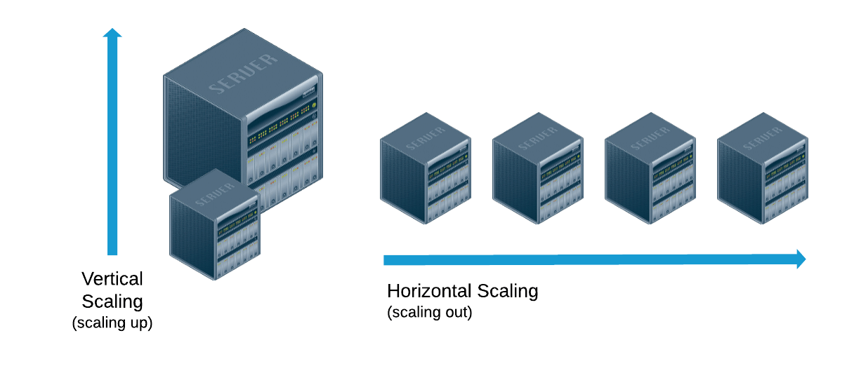
Types of Scaling

Slide 16
Scalability
Any application or website that sees significant growth will eventually need to scale in order to accommodate increases in traffic. For data-driven applications and websites, it’s critical that scaling is done in a way that ensures the security and integrity of their data.

Slide 17
Scalability
It can be difficult to predict how popular a website or application will become or how long it will maintain that popularity, which is why some organizations choose a database architecture that allows them to scale their databases dynamically.

Slide 18
Database Sharding
Sharding is a database architecture pattern related to horizontal scaling, the practice of separating one table’s rows into multiple different tables, known as partitions.

Slide 19
Database Sharding
Each partition has the same schema and columns, but also entirely different rows. Likewise, the data held in each partition is unique and independent of the data held in other partitions.

Slide 20
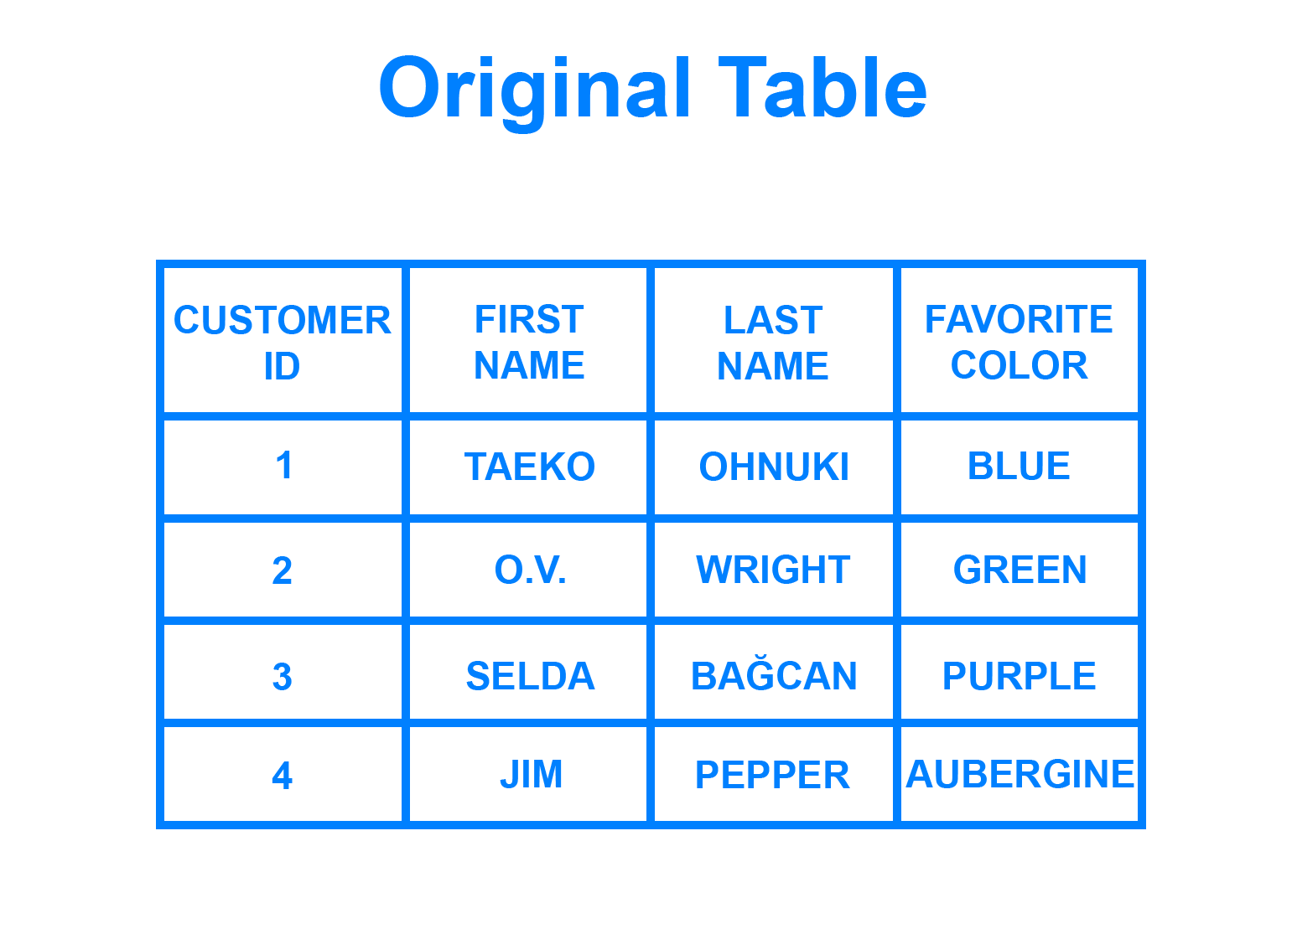
Database Sharding

Slide 21
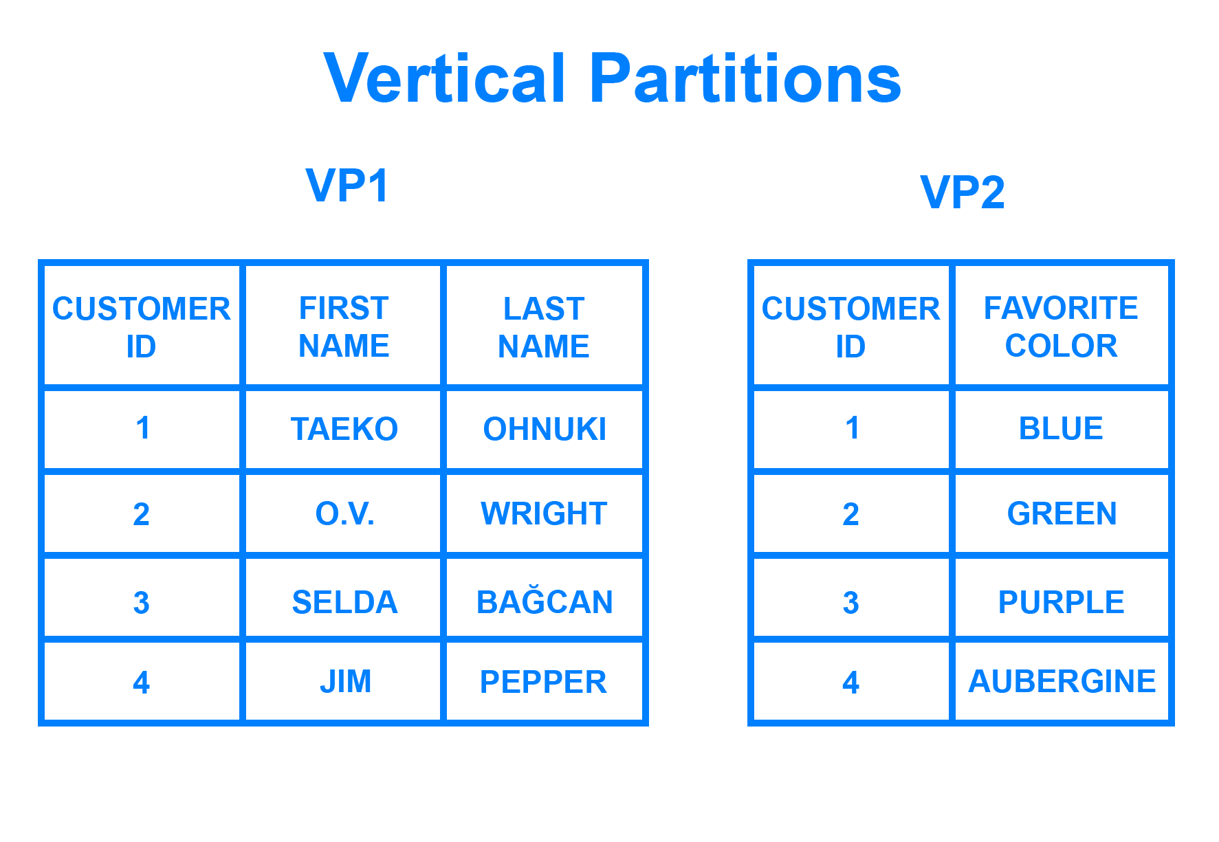
Database Sharding

Slide 22
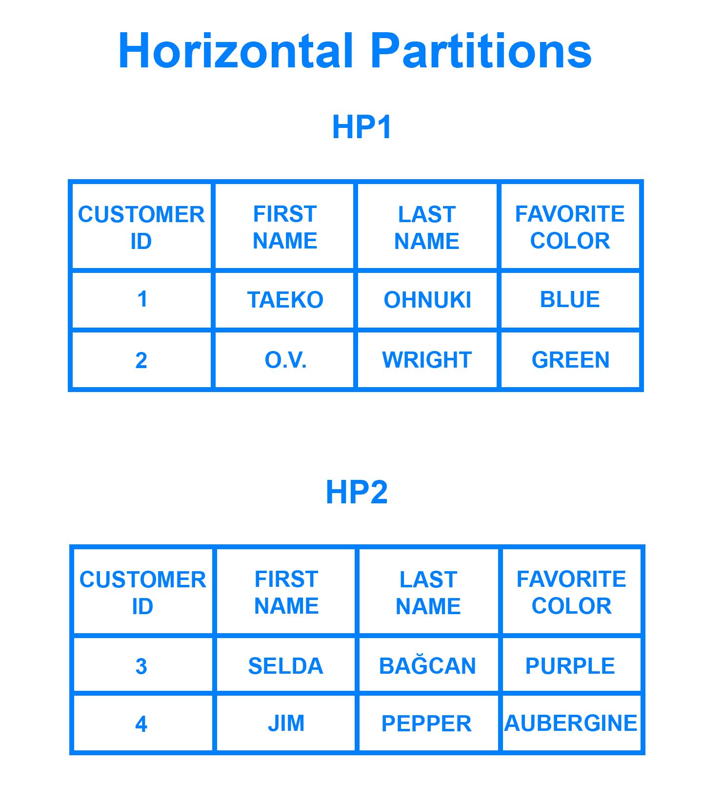
Database Sharding

Slide 23
Database Sharding
Sharding involves breaking up the data into two or more smaller chunks, called logical shards. The logical shards are then distributed across separate database nodes, referred to as physical shards, each of which can hold multiple logical shards.

Slide 24
Database Sharding
Database shards exemplify a shared-nothing architecture.
This means that the shards are autonomous, they don’t share any of the same data or computing resources.

Slide 25
Database Sharding
Often, sharding is implemented at the application level, meaning that the application includes code that defines which shard to transmit reads and writes to.

Slide 26
Database Sharding
However, some database management systems have sharding capabilities built in, allowing you to implement sharding directly at the database level.

Slide 27
Sharding Architectures
Once you’ve decided to shard your database, the next thing you need to figure out is how you’ll go about doing so.

Slide 28
Sharding Architectures
When running queries or distributing incoming data to sharded tables or databases, it’s crucial that the data goes to the correct shard.

Slide 29
Sharding Architectures
Otherwise, it could result in lost data or painfully slow queries.

Slide 30
Key-Based Sharding
Key-based sharding, also known as hash-based sharding, involves using the value of some field(s) taken from data, such as a customer’s ID number, a client application’s IP address, or a ZIP code, and plugging that value into a hash function to determine which shard the data should go to.

Slide 31
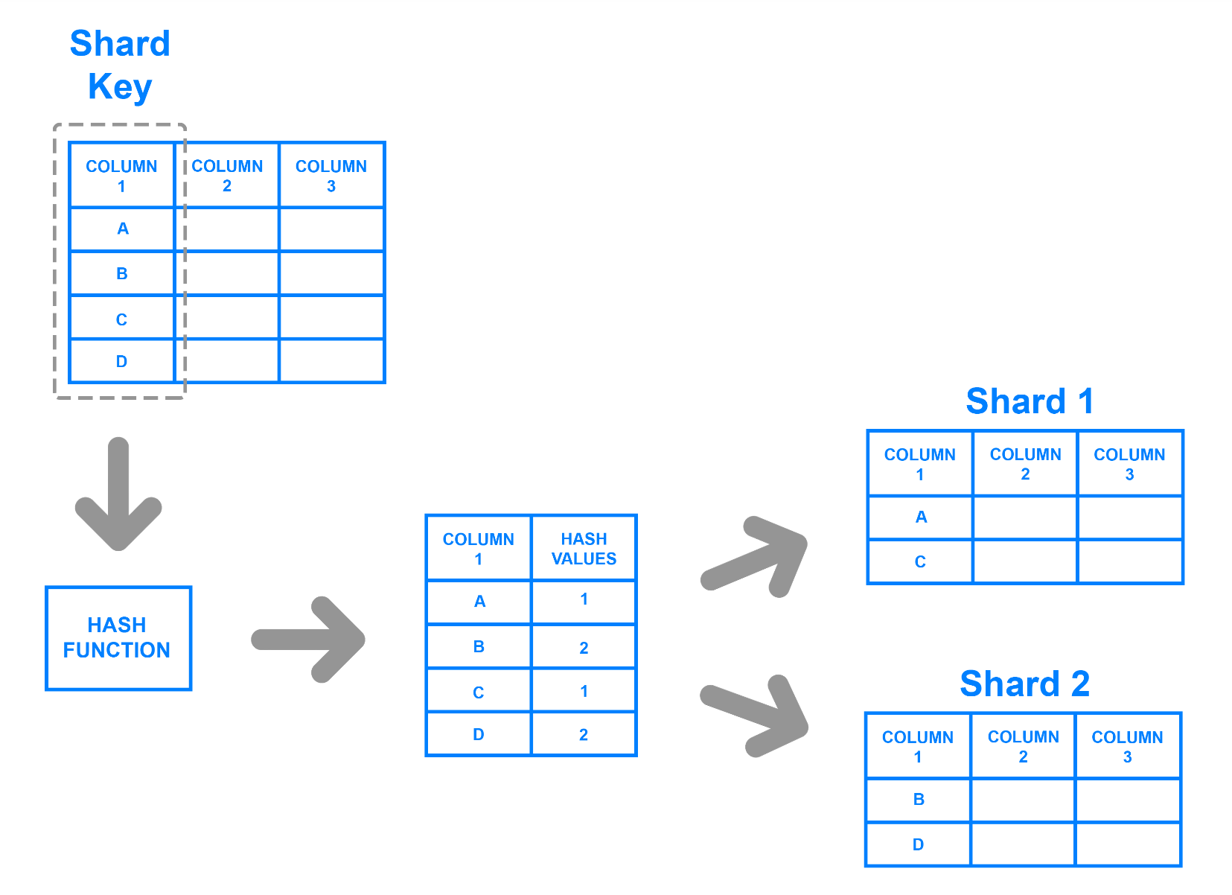
Key-Based Sharding

Slide 32
Key-Based Sharding
To ensure that entries are placed in the correct shards and in a consistent manner, the values entered into the hash function should all come from the same column.
This column is known as a shard key.

Slide 33
Key-Based Sharding
To ensure that entries are placed in the correct shards and in a consistent manner, the values entered into the hash function should all come from the same column.
This column is known as a shard key.

Slide 34
Key-Based Sharding
In simple terms, shard keys are similar to primary keys in that both are columns which are used to establish a unique identifier for individual rows.

Slide 35
Key-Based Sharding
Broadly speaking, a shard key should be static, meaning that it shouldn’t contain values that might change over time.
Otherwise, it would increase the amount of work that goes into operations, and could slow down performance.

Slide 36
Range-Based Sharding
Range-based sharding involves sharding data based on ranges of a given value.

Slide 37
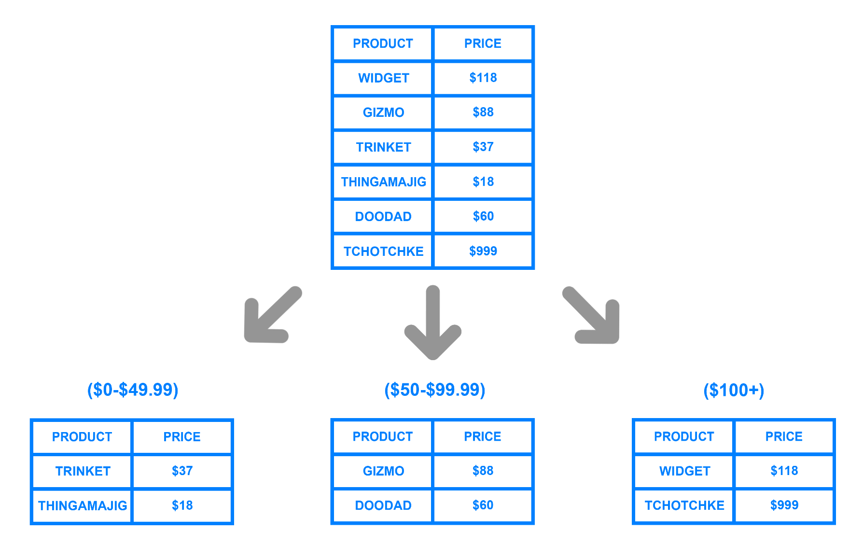
Range-Based Sharding

Slide 38
Some Drawbacks of Sharding
While sharding fairly common, it can make things tricky when trying to dynamically add additional servers to or remove servers from a database.

Slide 39
Some Drawbacks of Sharding
As you add servers, each new server will need a corresponding hash value and many of your existing entries, if not all of them, might need to be remapped to their new, correct hash values and then migrated to the appropriate servers.

Slide 40
Some Drawbacks of Sharding
As you begin rebalancing the data, the old hash values could become invalid.

Slide 41
Some Drawbacks of Sharding
Consequently, your server may not be able to write any new data during the migration and your application could be subject to downtime.

Slide 42
Some Drawbacks of Sharding
Looking at the previous example diagram, even if each shard holds an equal amount of data, the odds are that specific products will receive more attention than others.

Slide 43
Some Drawbacks of Sharding
Their respective shards will, in turn, receive a disproportionate number of reads, leading to database hotspots.

Slide 44
Should You Use Database Sharding?
Whether or not one should implement a sharded database architecture is almost always a matter of debate.

Slide 45
Should You Use Database Sharding?
Some see sharding as an inevitable outcome for databases that reach a certain size, while others see it as a headache that should be avoided unless it’s absolutely necessary, due to the operational complexity that sharding adds.

Slide 46
Some Scenarios Where Database Sharding is Recommended
The amount of application data grows to exceed the storage capacity of a single database node.

Slide 47
Some Scenarios Where Database Sharding is Recommended
The volume of writes or reads to the database surpasses what a single node can handle, resulting in slowed response times or timeouts.

Slide 48
Some Scenarios Where Database Sharding is Recommended
The network bandwidth required by the application outpaces the bandwidth available to a single database node, resulting in slowed response times or timeouts.

Slide 49
Some Other Options
Setting up a remote database
Implementing caching
Upgrading to a larger server

Slide 50
Setting Up A Remote Database
If you’re working with a monolithic application in which all of its components reside on the same server, you can improve your database’s performance by moving the database over to its own machine.

Slide 51
Implementing Caching
If your application’s read performance is what’s causing you trouble, caching is one strategy that can help to improve it. Caching involves temporarily storing data that has already been requested in memory, allowing you to access the data much more quickly later on.

Slide 52
Upgrading To A Larger Server
In most cases, scaling up one’s database server to a machine with more resources requires less effort than sharding. Though an upgraded server with more resources will likely cost more money. Accordingly, you should only go through with resizing if it truly ends up being your best option.

Slide 53
Some Other Options
Please remember that if your application or website grows past a certain point, none of these three strategies will be enough to improve performance on their own. In such cases, sharding may indeed be the best option for you.

